Slide 1
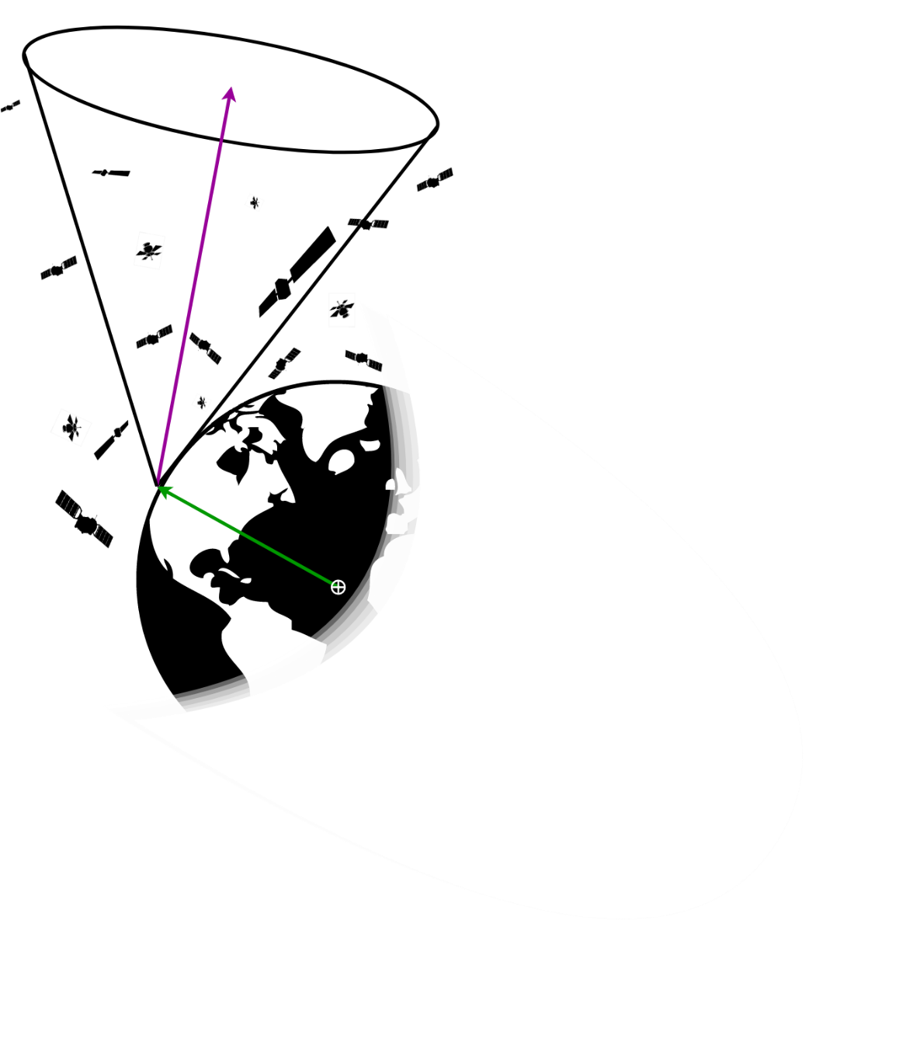
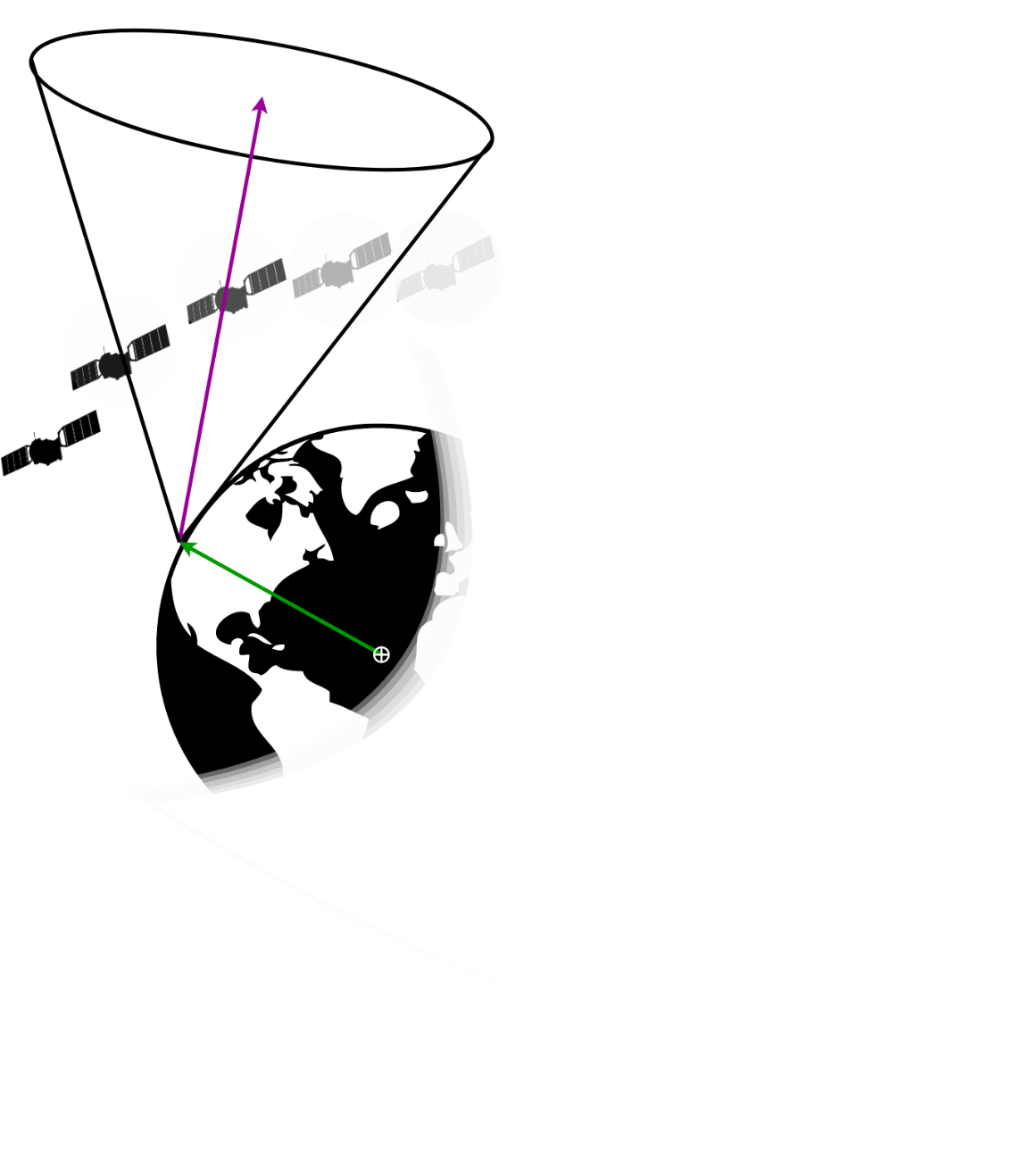
Optimizing Ground Sensor Placement
Dean Keithly Space Vehicles PhD Candidate Robert Sivilli
Probabilistically: How many spacecraft are in a Sensor FOV?
Probabilistic detection of spacecraft in a Sensor FOV?
Presenter: Dean Keithly

Slide 2
Process Diagram
Download data from the Unified Data Library, Jet Propulsion Laboratory, Ground Station Positions (blue)
Extract out Orbital Elements from TLE and calculated values
Model Probability Density Functions (PDF) and Joint PDF
Combine KOE into spacecraft distributions
Calculate Cone Volume Integrals
Presenter: Dean Keithly

Slide 3
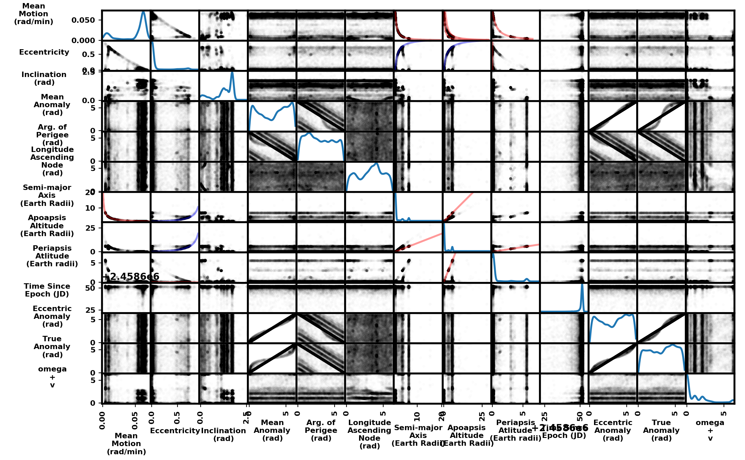
Keplerian Orbital Element
Inter-dependence
Along Diagonal: Kernel Density Estimates
(Probability Density Functions)
Each plot contains 17,966 spacecraft
Convert 5 (blue) scatter plots into joint probability distributions
Model PDFs w/ Rectilinear Bivariate Splines
Use eccentricity to drive sampling
Use Inverse Transform Sampling on Cumulative Distribution Function
Keplerian Orbital
Elements (KOE)
Joint Probability Density
Function Used
A ‘0’ slope indicates no dependence
Presenter: Dean Keithly

Slide 4
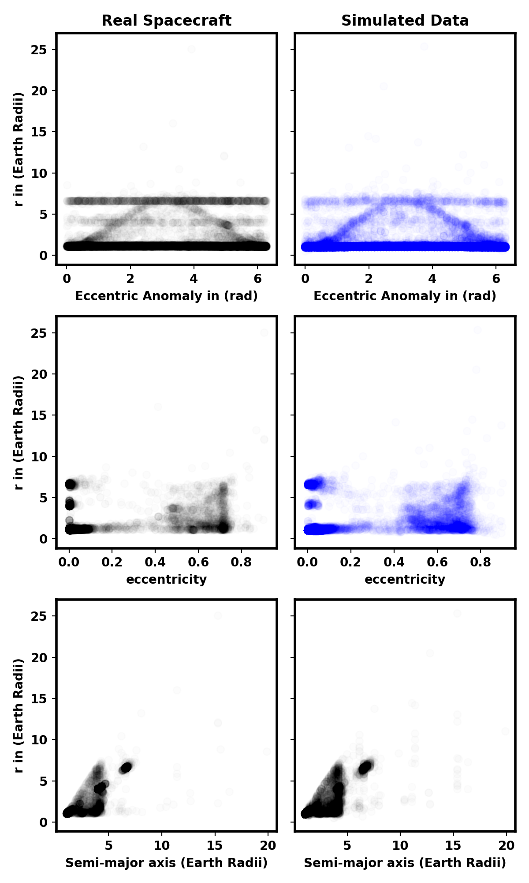
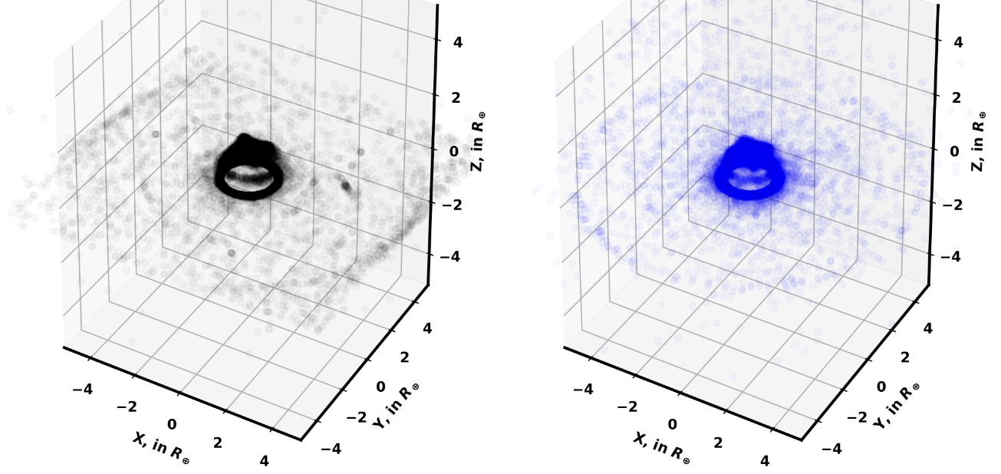

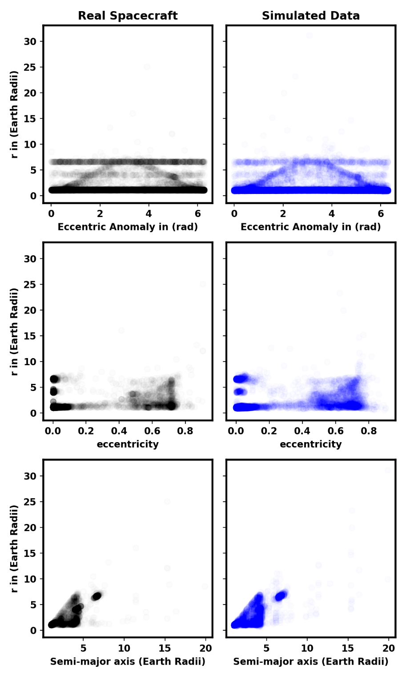
Simulating Spacecraft KOE
My sampling technique synthetically replicates underlying satellite state-vectors
Apparent ‘Fuzziness’ is caused by discretization of population space
Real SC: 17,966
Simulated SC: 20,000
Presenter: Dean Keithly

Slide 5
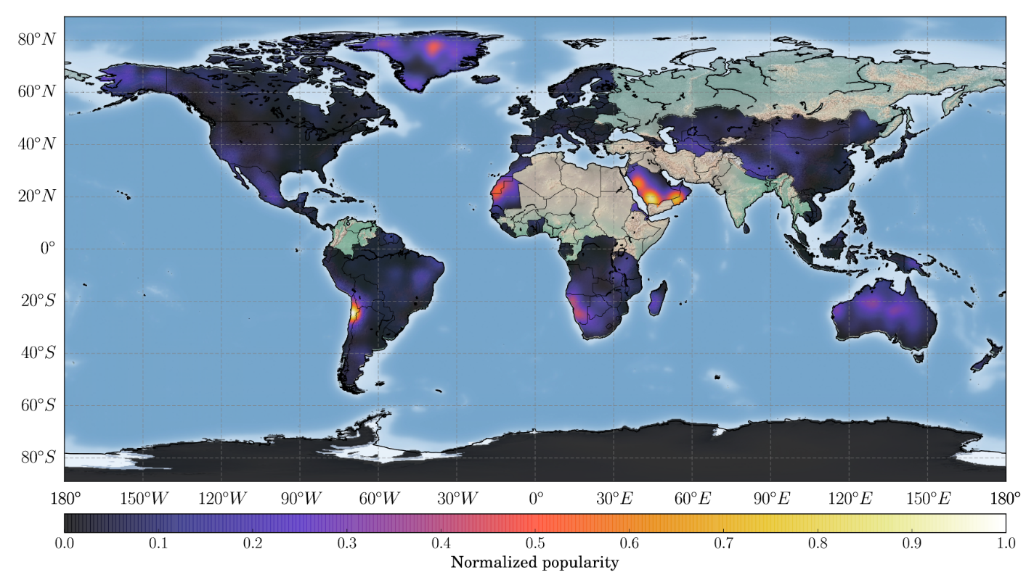
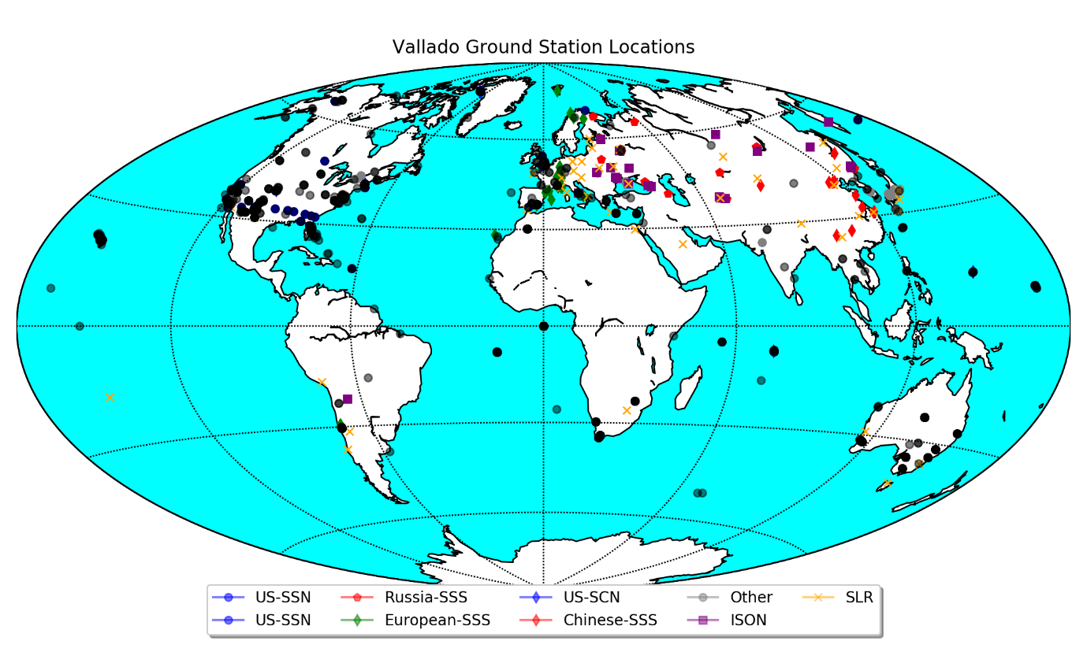
Ground Station Optimization
By combining:
Volume Integrals + Vmag integrals
At specific times
Over all elevations and azimuths
Of varying Sensors at Lat-Lon
Over previous probability distributions
We get:
Optimal observing Elevation-Azimuth for each Lat-Lon, t
Maximum expected number of spacecraft detections
Information where to place additional sensors
Utility of low capability sensors
*Results will look similar to this from Del Portillo 2017 Paper*
WHAT MORE COULD YOU ASK FOR BY WEEK 7 OF THE PROGRAM
Presenter: Dean Keithly

Slide 6

Simulating Spacecraft KOE
Presenter: Dean Keithly

Slide 7

Simulating Spacecraft KOE
Presenter: Dean Keithly

Slide 8
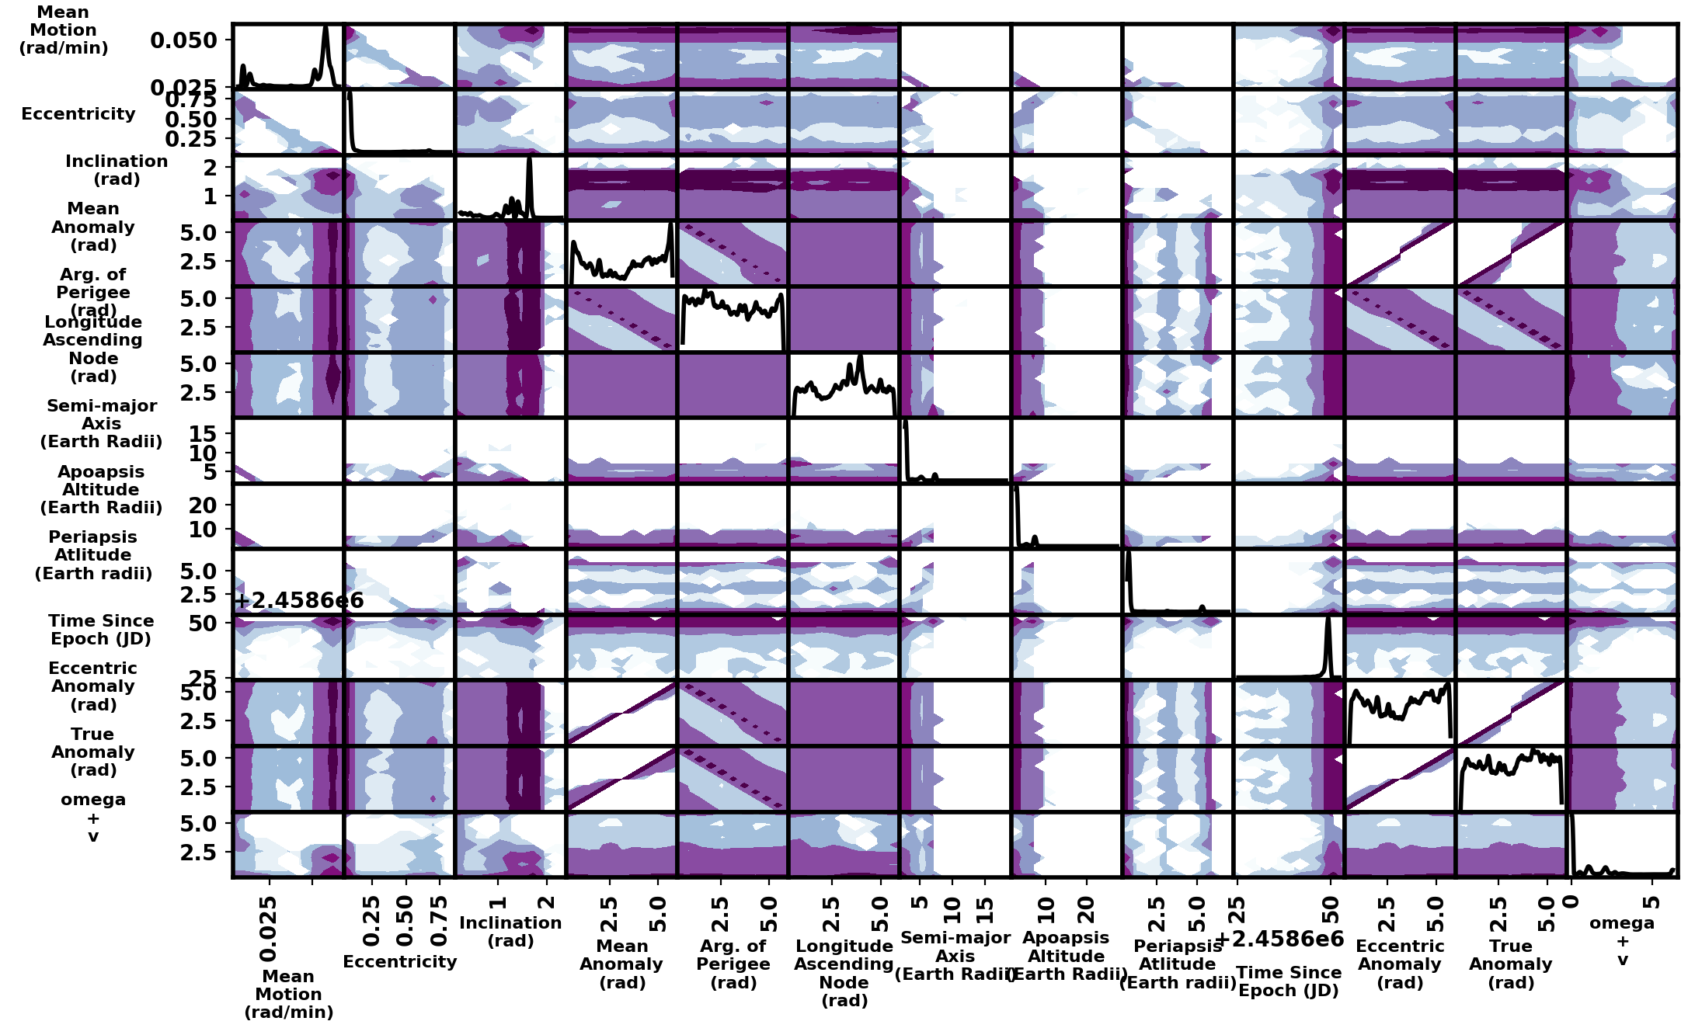
Colors
Presenter: Dean Keithly

Slide 9
Dean Keithly Space Vehicles PhD Candidate Robert Sivilli
The following slides are guidance for preparing the technical briefing and to maintain consistency among the briefings.
The briefing must be a maximum of five (5) PowerPoint slides.
No animations or links to other slides/sites/documents are allowed.
Use an Arial font and select the appropriate font sizes for headers, sub-headers and text.
Directorate: Please use “Space Vehicles” or “Directed Energy”
Presenter: Dean Keithly

Slide 10
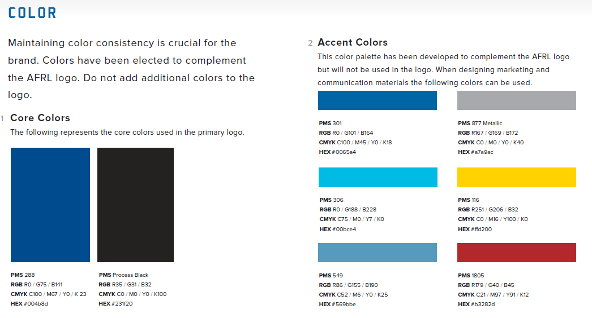
Colors
Presenter: Dean Keithly

Slide 11
Distribution Statement
A distribution statement has been included on the slide Master and must not be removed.
Presenter: Dean Keithly

Slide 12
Overview
BLUF (Bottom Line Up Front)
Main Points
Support
Conclusion
Explain the overall purpose of the research, e.g. what is the problem.
Explain your experimental approach, including reference of graphics if applicable, e.g. how you tackled the challenges and what options are possible to solve the problem.
Explain the potential future research, e.g., where the research should go next.
Presenter: Dean Keithly
“DISTRIBUTION C – Distribution authorized to U.S. Government Agencies and their contractors; Technical content [date of poster session].”

Slide 13
Slide Layout
Goal: Professional, stand-alone briefings
Only use high-value data
Use enough detail to describe meaning without oversimplifying message
Use animation / build effects if they enhance or strengthen your message
Provide clear classification markings if classified
Try to keep main bullets = one line
Sub bullets provide more detail
Avoid just one sub-bullet (if possible)
Fourth level
Fifth level
Presenter: Dean Keithly

Slide 14
Bell Curve Charts
Charts & graphs help tell the story
Keep them simple, relevant, and readable
# of Storms
Instructions for making a chart
Click the “Insert” tab
Click on the “Chart” button
Select “X Y (Scatter)” as chart to be inserted (it is the default selection)
Enter values in Excel spreadsheet that pops up when the chart is inserted on the PPT slide
Save PPT Slide and you are done!
Number of Storms in 1999
Quarter
Use the “ASPECT” color palette for Bell Curve Charts. It should be the default selection. Click the ‘Design “ tab, click on the ‘Colors” button on the right side, click on ‘Aspect”
Presenter: Dean Keithly

